Slide 1
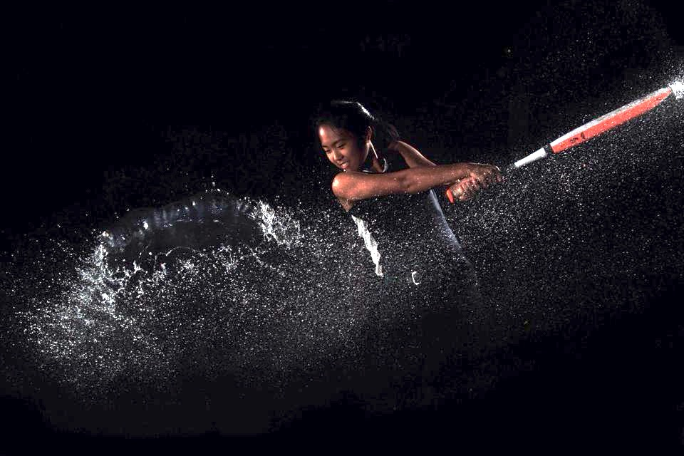
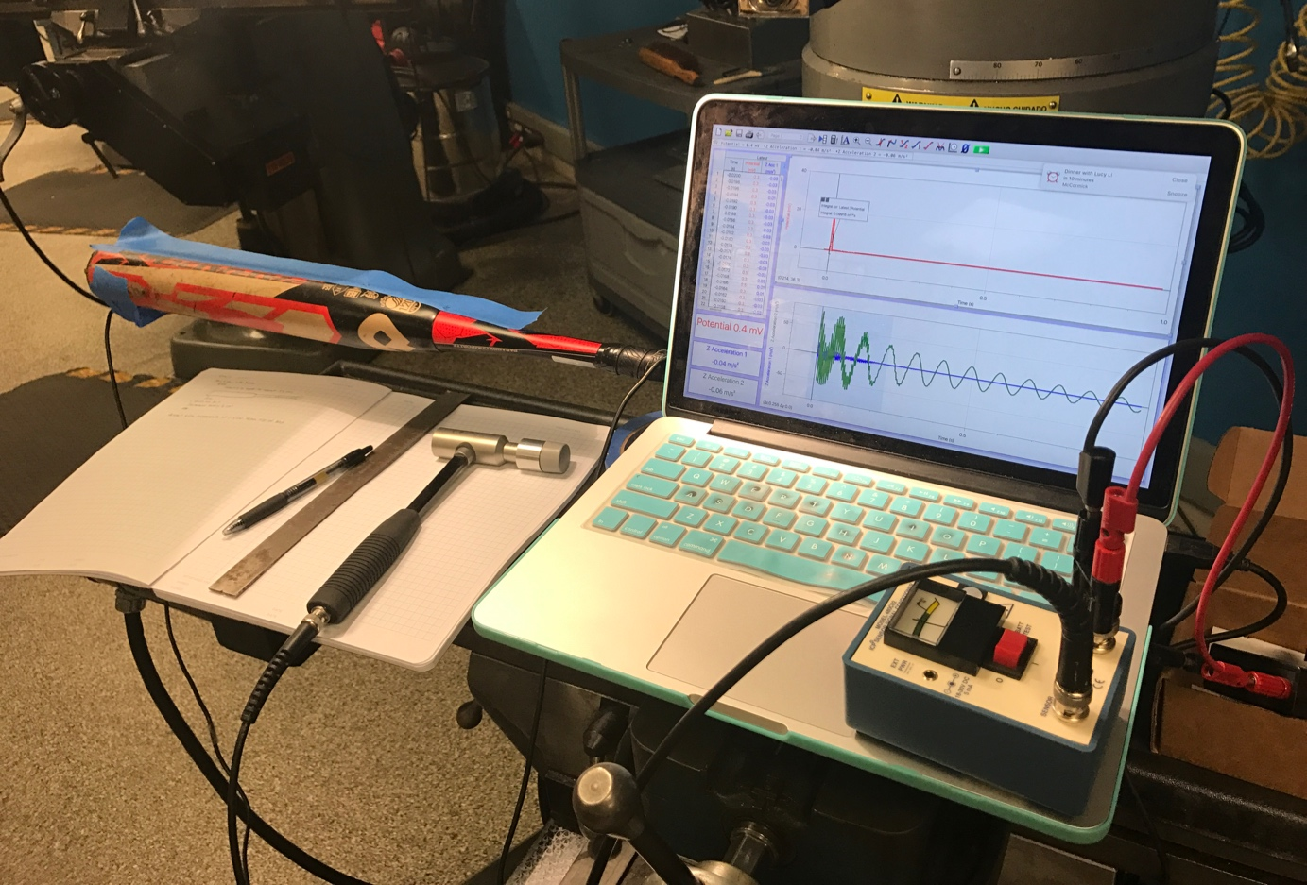
What Causes Bat Sting in Softball Bats?
Toria Yan
2.671 Thursday PM
Prof. Peter So
Notes:
Hi everyone, my name is Toria Yan and I researched the causes of bat sting in softball bats upon contact with a ball

Slide 2
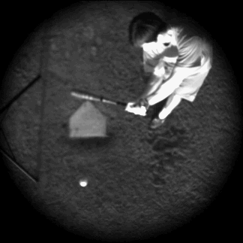
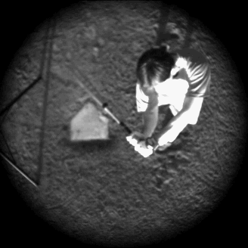
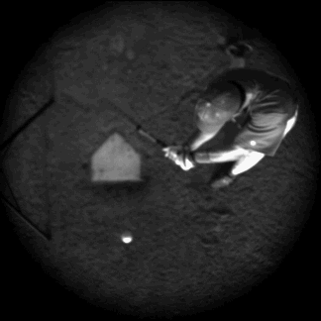
Bat Sting
Outside Pitch
Down the Middle Pitch
Inside Pitch
Source: http://www.acs.psu.edu/drussell/bats/sting-damp.html
Notes:
For those of you who haven’t swung a bat before, bat sting is the very painful stinging sensation in the hands after making contact with a ball.
If you take a look at these clips, you will notice that at the point of contact (the red circles) for an outside and inside pitch, there is a pretty violent jolt at the hands compared to a down the middle pitch, which resulted in almost no movement in the hands. Why does this happen?

Slide 3
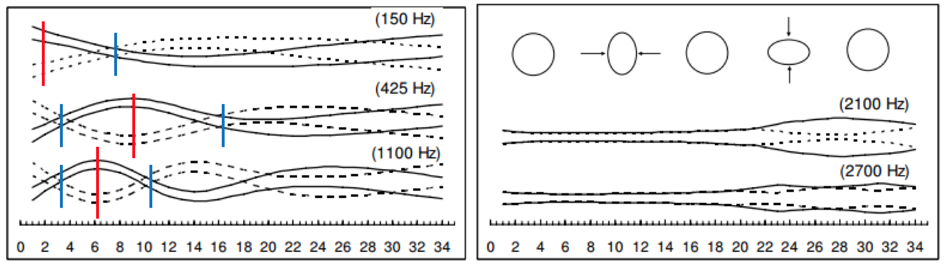
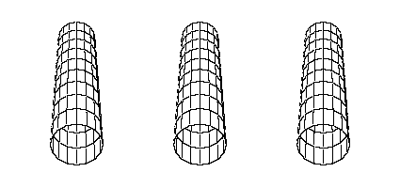



Bat Vibrational Modes
Anti-node
Node
Bat Bending
Hoop Bending
http://www.acs.psu.edu/drussell/Demos/batvibes.html
Notes:
There are two types of vibrational modes that contribute to bat sting felt. The more intuitive one being bat bending.
During bat bending, each mode has nodes and anti-nodes. If the hands are placed at a node, there is no movement in the bat and therefore no bat bending vibration felt in the hands. At an anti-node however, there is a good amount of vertical displacement. If hands are placed here, they will feel this kicking out as bat sting.
There is also hoop bending in the bat, meaning the material will actually deform depending on the impact on the bat.
I wanted to find the spot on the bat where there is minimal vibrations felt (otherwise known as the sweet spot)

Slide 4
Experimental Setup
Vernier Instrumentation Amplifier
Impact Hammer PCB model
086D05
Vernier LabQuest Mini
Laptop
Impact Location Markers
Accelerometer 1
Softball bat
Horseshoe clamp and V-block
Accelerometer 2
Notes:
To find the location with minimal bat sting, I clamped down a softball bat and attached an accelerometer at the tip of the bat and the handle of the bat.
I then used an impact hammer to hit the bat at marked increments along the barrel and measured the acceleration at both locations

Slide 5
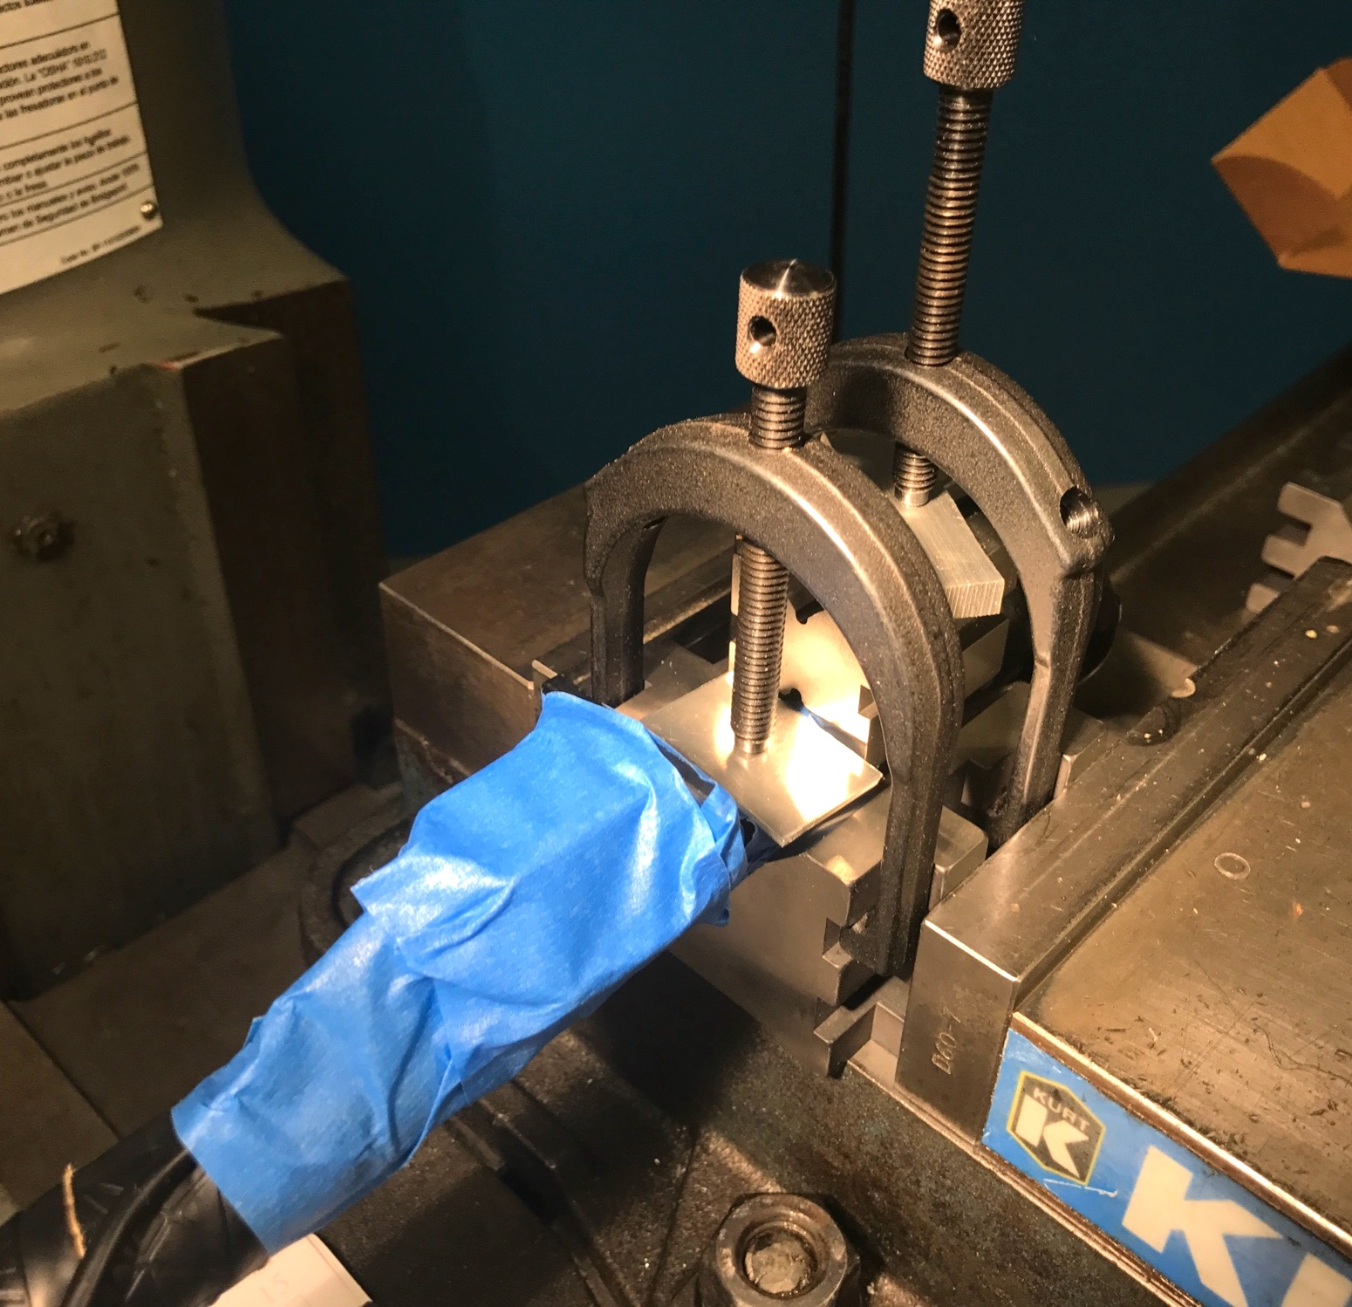
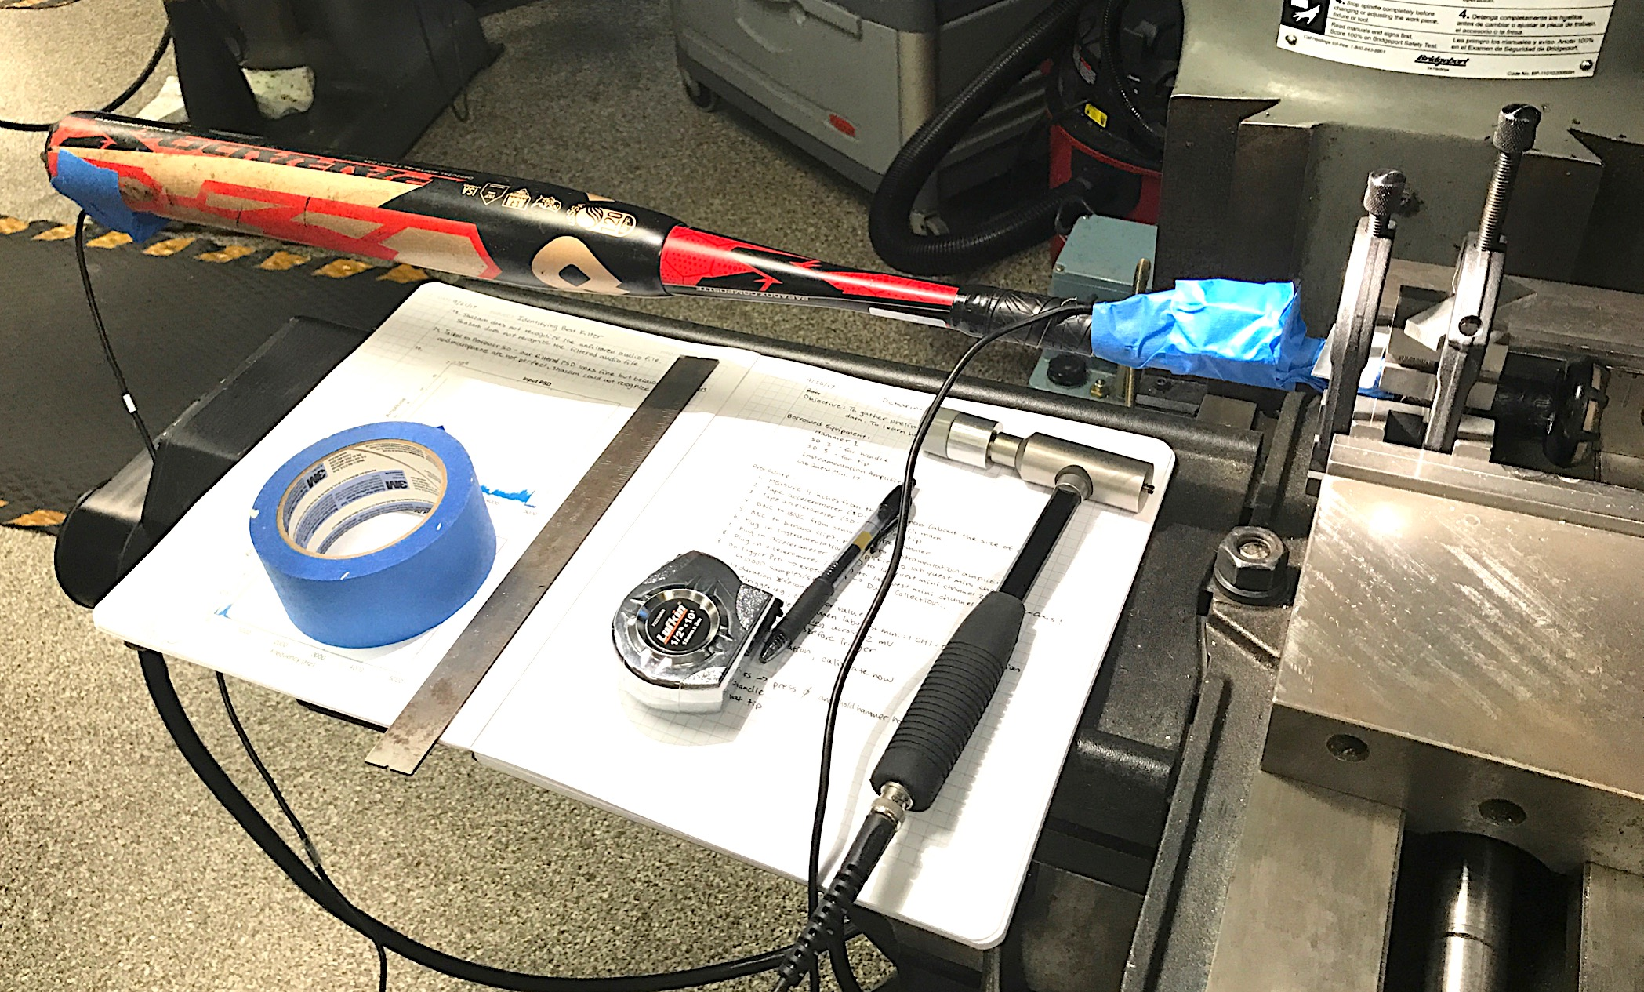
Clamping a Softball Bat
Notes:
Clamping the bat was difficult because of how heavy it was.
To hold it in place, I used horseshoe clamps and v-blocks, and clamped the v-blocks in a vice.

Slide 6
RESULTS

Slide 7
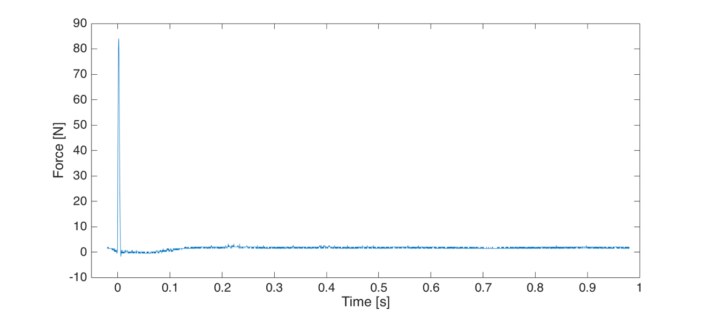
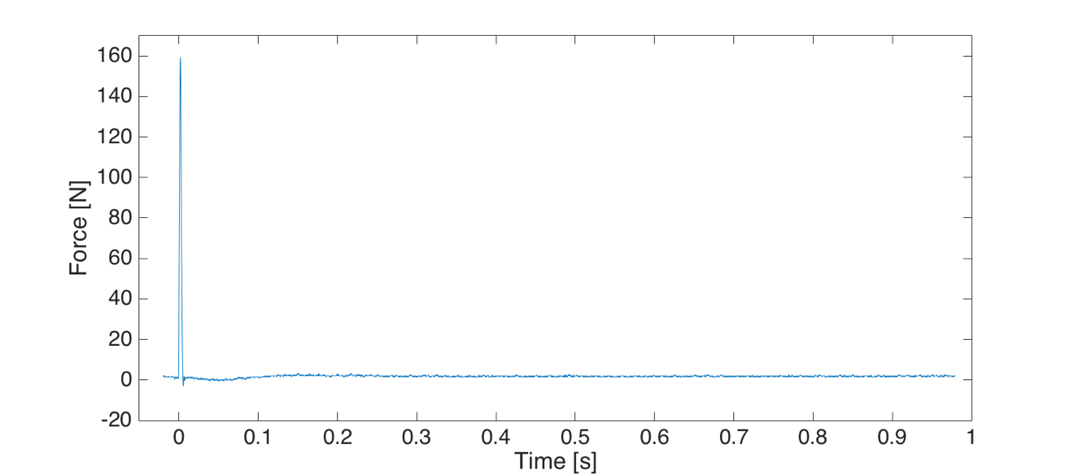
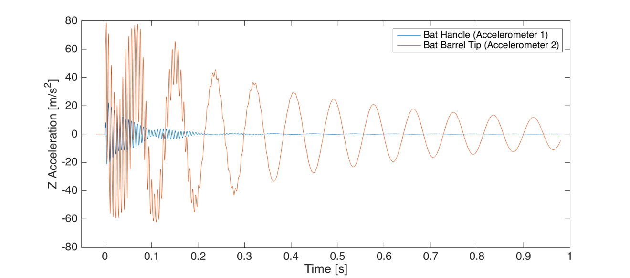
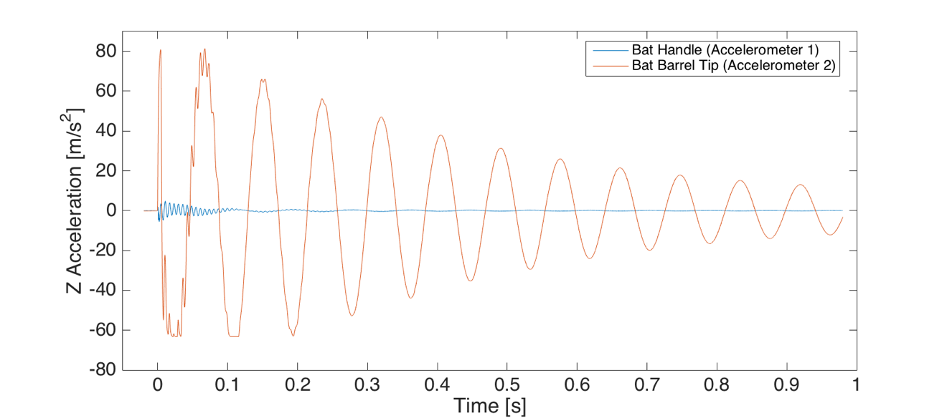
Measured Bat Vibration
Impact at Tip of Bat Barrel
Impact near Middle of Barrel
Notes:
When comparing the data collected at the tip of the bat barrel and near the middle of the bat barrel, I found that there was much more signal from the impact location at the tip of the bat.
I determined that the larger sinusoidal wave with a lower frequency was from the bat bending, and the high frequency signal was from the hoop bending within the bat.

Slide 8
Resonant Frequencies
Peak: 12 Hz
Peak: 160 Hz
Notes:
The FFT of my data showed exactly what we saw before, a 12 Hz peak (due to bat bending) and a 160 Hz peak (due to hoop bending)

Slide 9
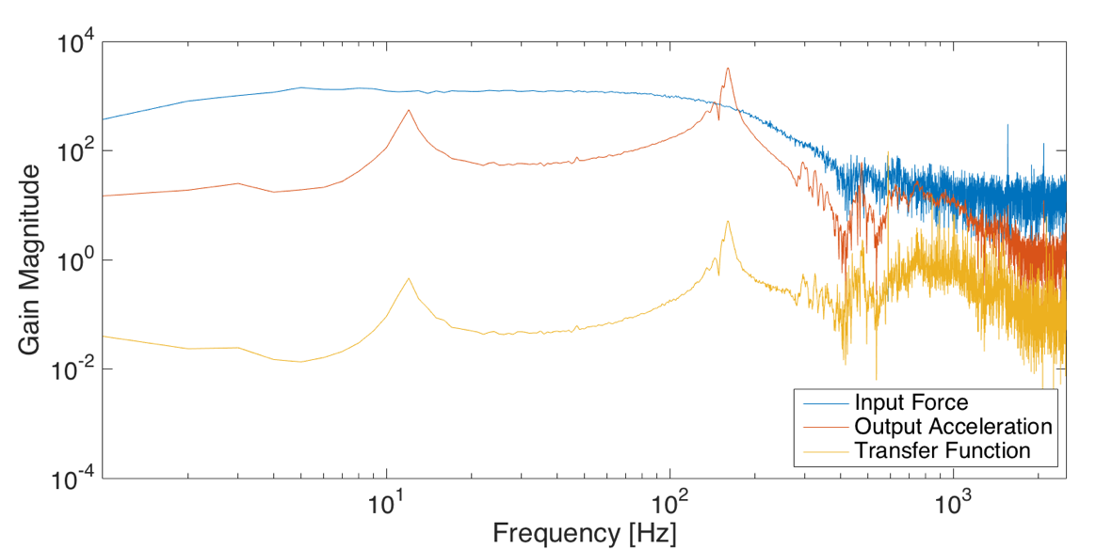
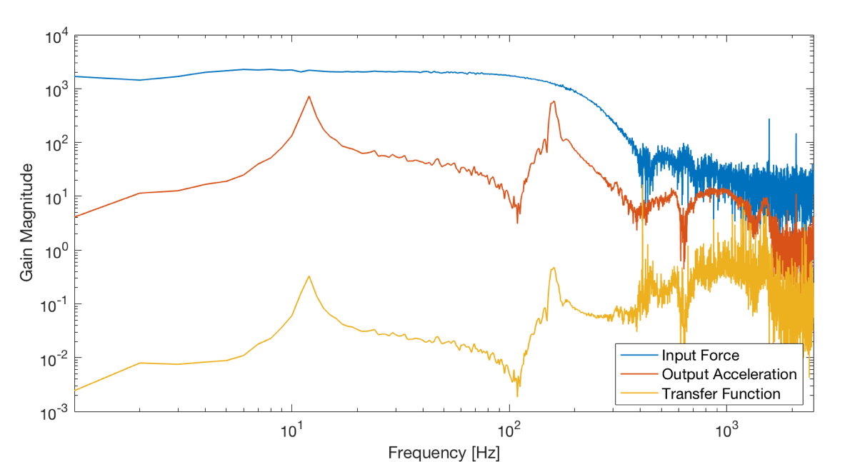
Gain for Accelerometer at Handle
12 Hz
160 Hz
12 Hz
160 Hz
Impact at Tip of Bat Barrel
Impact near Middle of Barrel
Notes:
I found the bode plots for each test run and measured the gain value at each peak frequency.
The gain for the impact at the tip of the bat barrel is higher than the gain near the middle of the barrel

Slide 10
Average Gain Magnitude Peaks
12 Hz Peak
160 Hz Peak
Sweet Spot
Notes:
Here are the graphs of the average gain magnitude peak values.
You’ll notice that the scale for gain is much smaller for the 12 Hz peaks than the scale for the 160 Hz peaks.
You can also see a very clear correlation between the magnitude of gain and the impact location along the bat
From this graph, we can guess that the sweet spot of the bat is somewhere between 10 cm and 20 cm from the tip of the bat

Slide 11
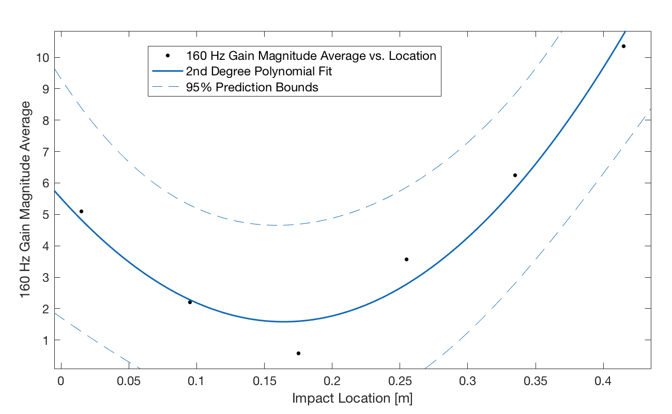
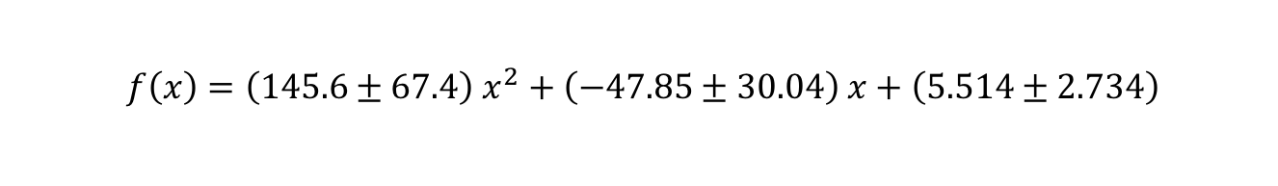
Finding the Sweet Spot
$$f\left(x\right)=\left(145.6±67.4\right) x^{2}+\left(−47.85±30.04\right) x+\left(5.514±2.734\right)$$
95% Certainty Bounds
Sweet Spot: 0.164m
Notes:
I actually mathematically found the sweet spot of my bat to be at around 16.4 centimeters from the tip of the bat.
This was the minimum of the best fit polynomial for my data and is the point where a batter will feel the least bat sting.

Slide 12
Conclusion
Of the two resonant frequencies, only the 160 Hz frequency contributes to the bat sting felt in a hitter’s hands
At the Sweet Spot of the bat, there is the least amount of response in the bat and the least amount of bat sting felt
Impact Locations further from the sweet spot of a bat result in an increase in bat sting felt in a hitter’s hands
Impacts near the handle result in more bat sting than at tip of bat
Notes:
I drew a few conclusions from my results.
This research is useful for those who do not understand the mechanics behind a softball bat and for those who want to minimize any painful stinging when they are hitting (starting swing earlier for inside pitch, later for outside pitch. This research could also be used by bat manufacturing companies to create internal or external sting dampeners to increase customer satisfaction.

Slide 13
How Do You Prevent Bat Sting?
Outside Pitch
Down the Middle Pitch
Inside Pitch
Source: http://www.acs.psu.edu/drussell/bats/sting-damp.html
Notes:
Going back to the page I showed you all before, here is the contact point for each pitch if the mechanics and timing of the swing are kept the same. You can see that easy way to avoid bat sting is to start the swing earlier for an inside pitch and later for an inside pitch, and now we know why.

